Slide 1
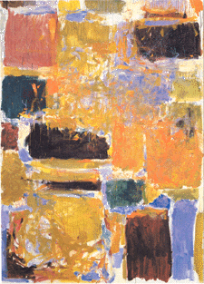
Digital Integrated Circuits
A Design Perspective
Jan M. Rabaey
Anantha Chandrakasan
Borivoje Nikolic
Design
Methodologies
December 10, 2002

Slide 2
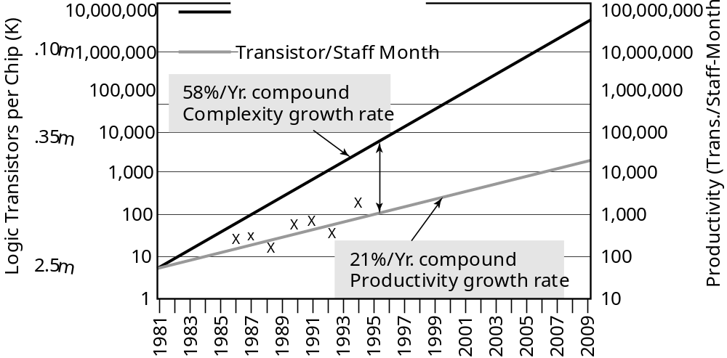
The Design Productivity Challenge
Logic Transistors per Chip (K)
Productivity (Trans./Staff-Month)
1981
1983
1985
1987
1989
1991
1993
1995
1997
1999
2001
2003
2005
2007
2009
A growing gap between design complexity and design productivity
Source: sematech97

Slide 3
A Simple Processor
MEMORY
INPUT/OUTPUT
CONTROL
INPUT-OUTPUT
DATAPATH

Slide 4
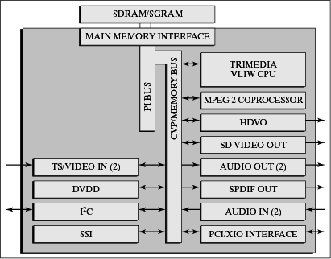
A System-on-a-Chip: Example
Courtesy: Philips

Slide 5
Impact of Implementation Choices
100-1000
Domain-specific processor
(e.g. DSP)
10-100
Embedded microprocessor
Energy Efficiency (in MOPS/mW)
1-10
Hardwired custom
Configurable/Parameterizable
0.1-1
None
Somewhat
flexible
Fully
flexible
Flexibility
(or application scope)

Slide 6
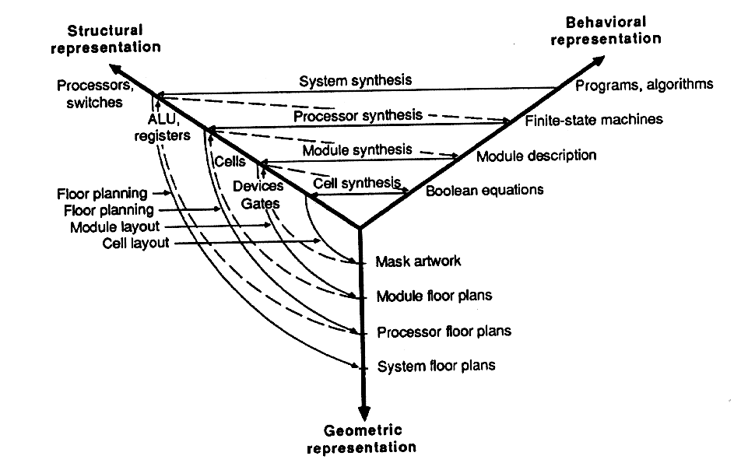
Design Methodology
Design process traverses iteratively between three abstractions:
behavior, structure, and geometry
More and more automation for each of these steps

Slide 7
Implementation Choices
Digital Circuit Implementation Approaches
Custom
Semicustom
Cell-based
Array-based
Standard Cells
Ma
cro Cells
Pre-diffused
Pre-wired
Compiled Cells
(Gate Arrays)
(FPGA's)

Slide 8
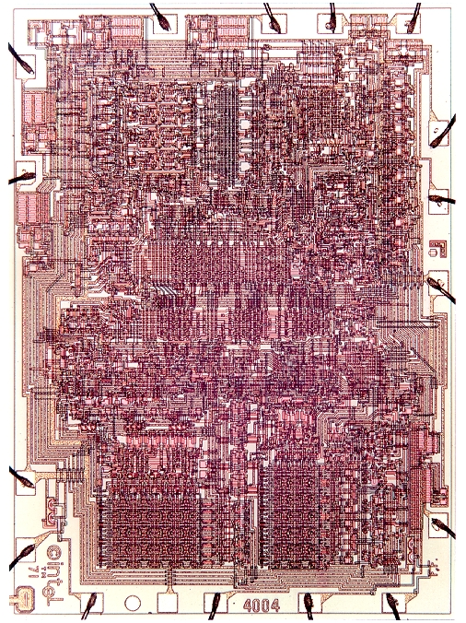
The Custom Approach
Intel 4004
Courtesy Intel

Slide 9
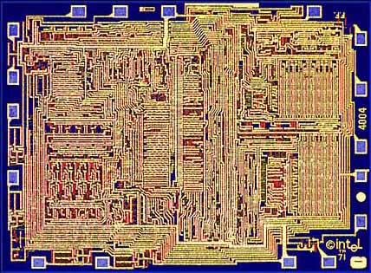
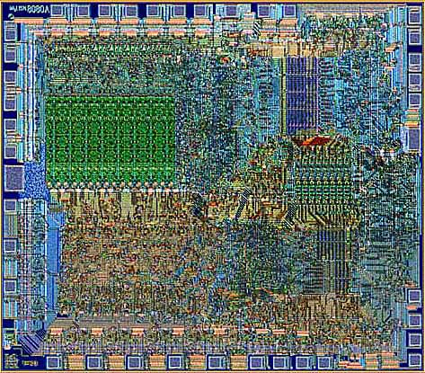
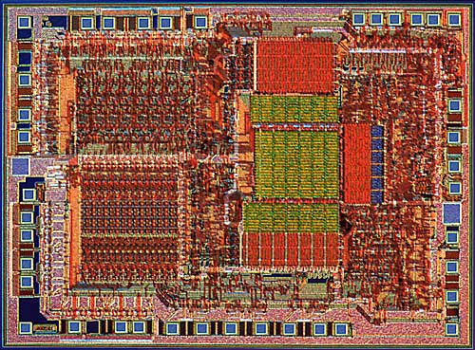
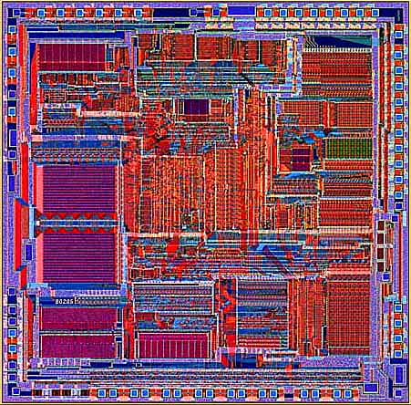
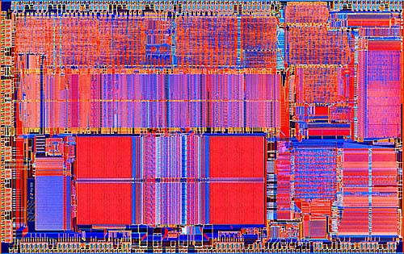
Transition to Automation and Regular Structures
Intel 4004 (‘71)
Intel 8080
Intel 8085
Intel 8286
Intel 8486
Courtesy Intel

Slide 10
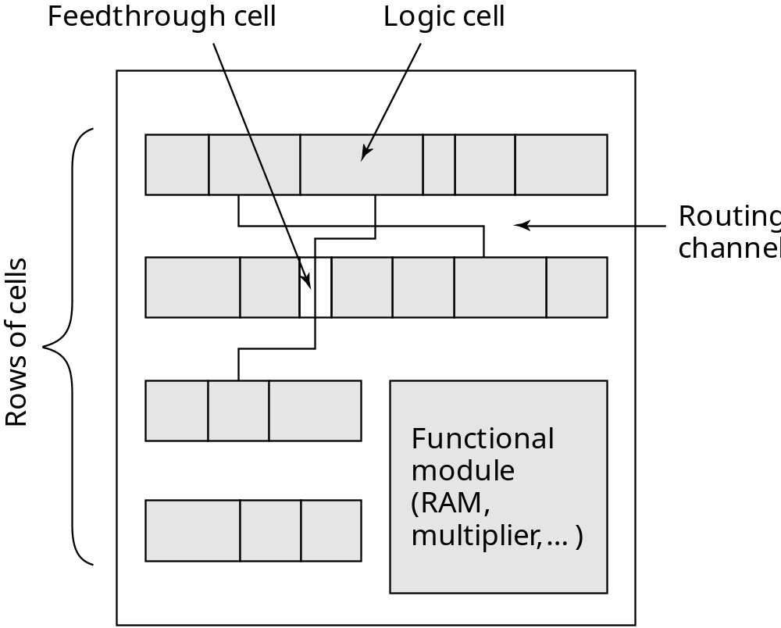
Cell-based Design (or standard cells)
Routing channel
requirements are
reduced by presence
of more interconnect
layers

Slide 11
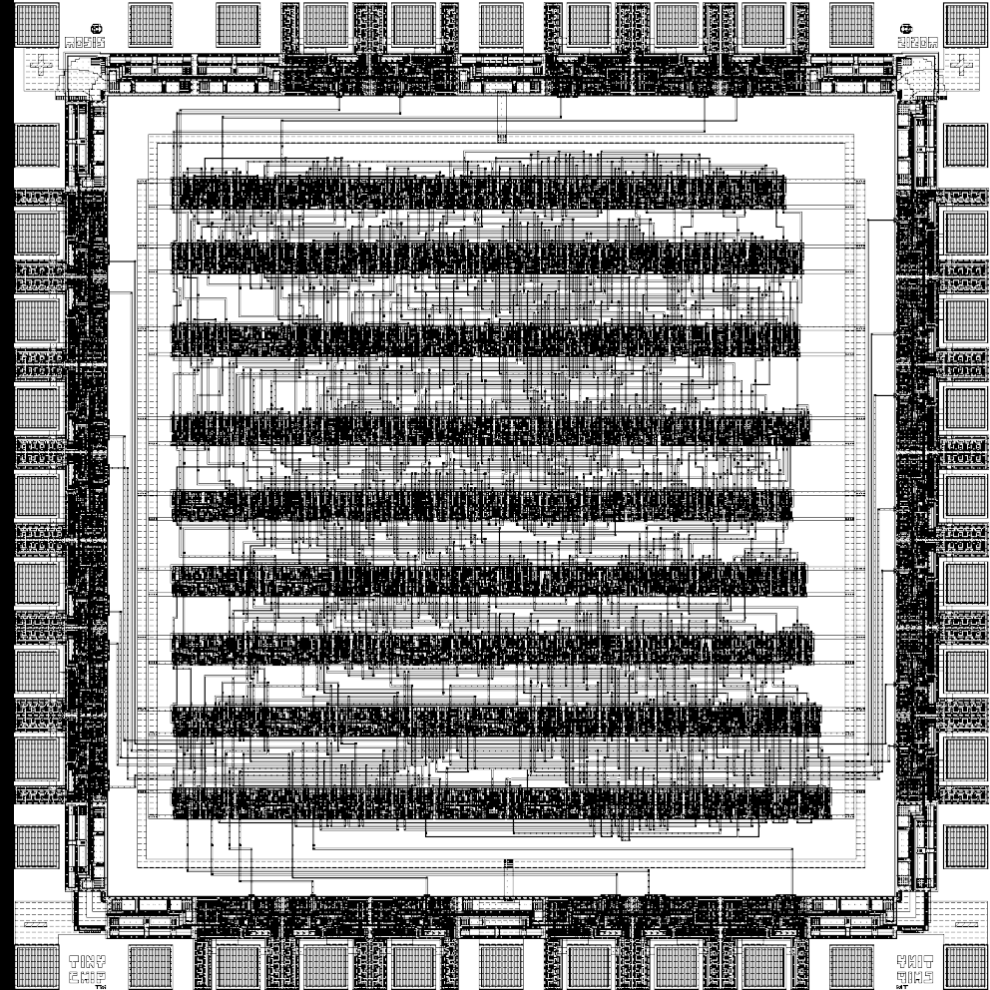
Standard Cell — Example
[Brodersen92]

Slide 12
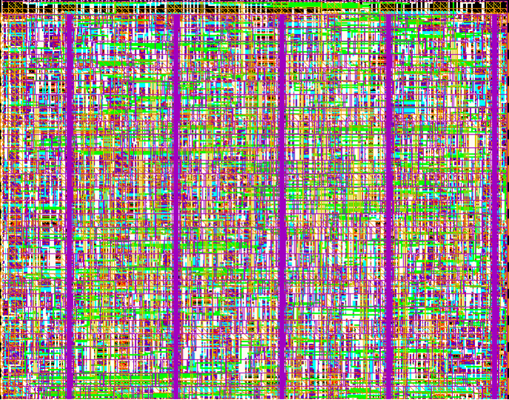
Standard Cell – The New Generation
Cell-structure
hidden under
interconnect layers

Slide 13
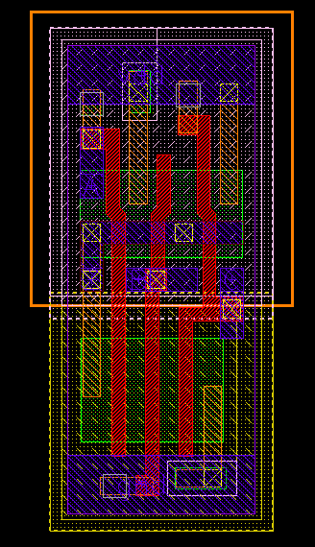
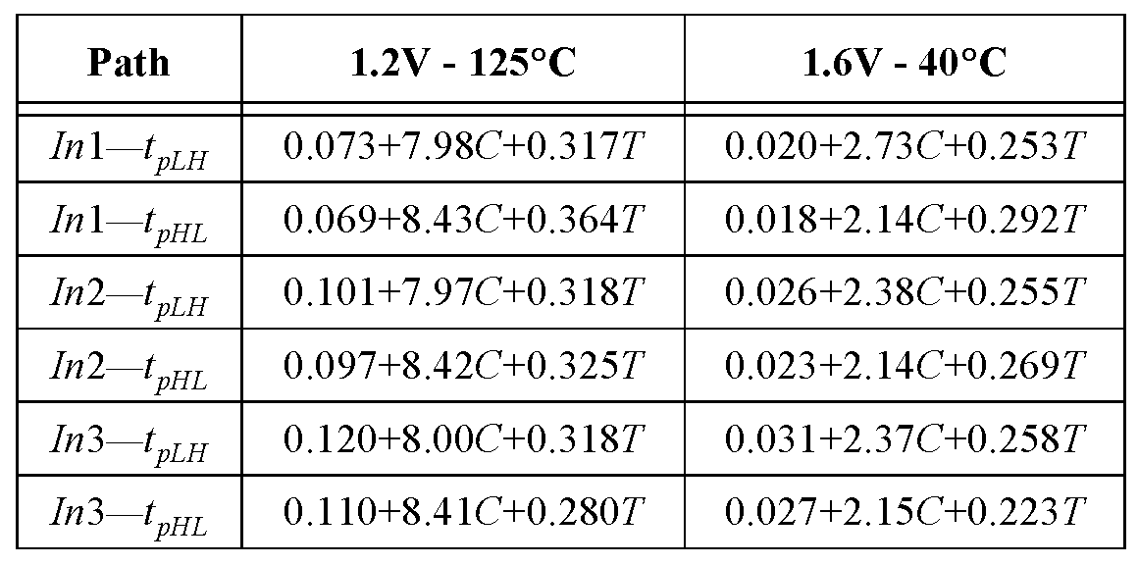
Standard Cell - Example
3-input NAND cell
(from ST Microelectronics):
C = Load capacitance
T = input rise/fall time

Slide 14
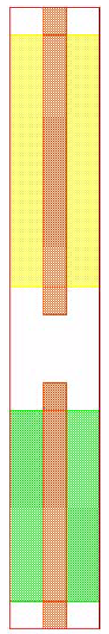
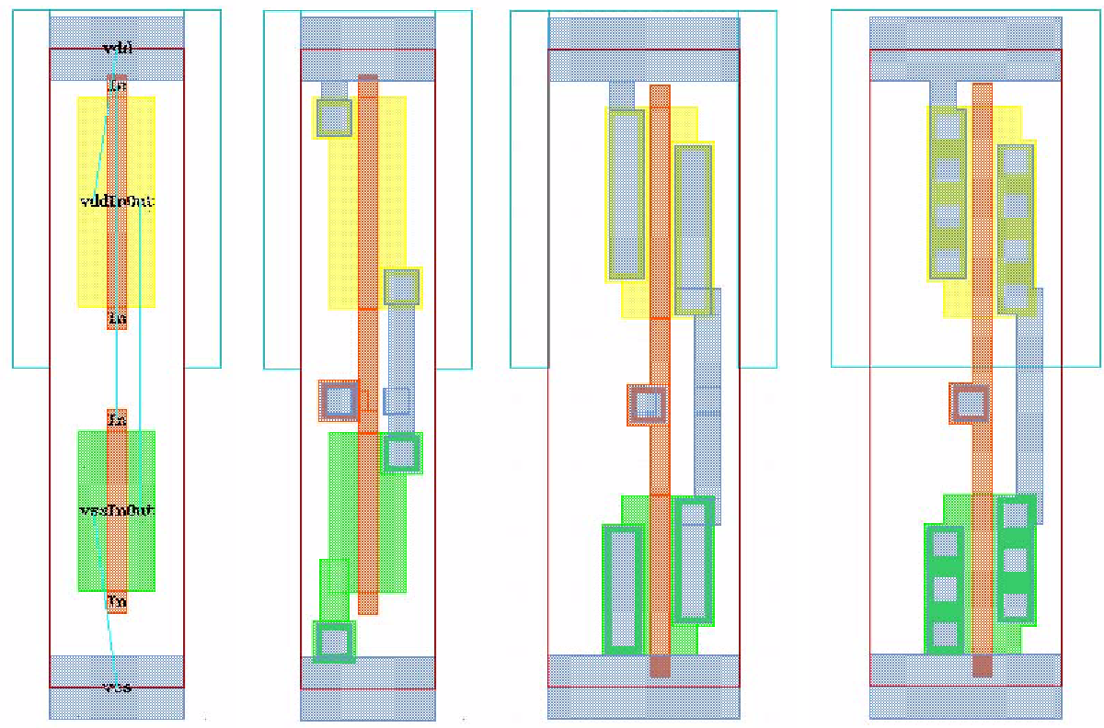
Automatic Cell Generation
Initial transistor
geometries
Placed
transistors
Routed
cell
Compacted
cell
Finished
cell
Courtesy Acadabra

Slide 15
A Historical Perspective: the PLA
Product terms
x
0
x
1
AND
x
2
OR
plane
plane
f
0
f
1
x
0
x
1
x
2

Slide 16
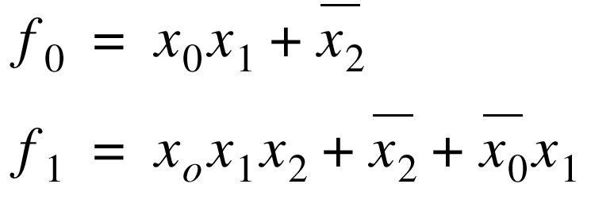
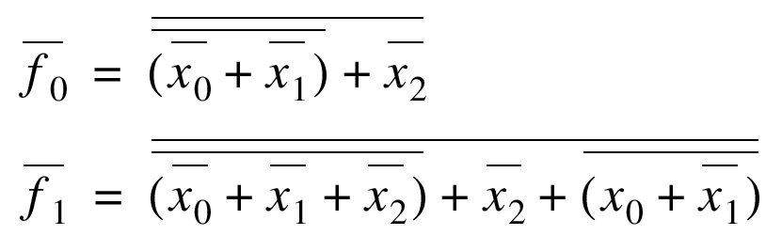
Two-Level Logic
Every logic function can be
expressed in sum-of-products
format (AND-OR)
minterm
Inverting format (NOR-NOR) more effective

Slide 17
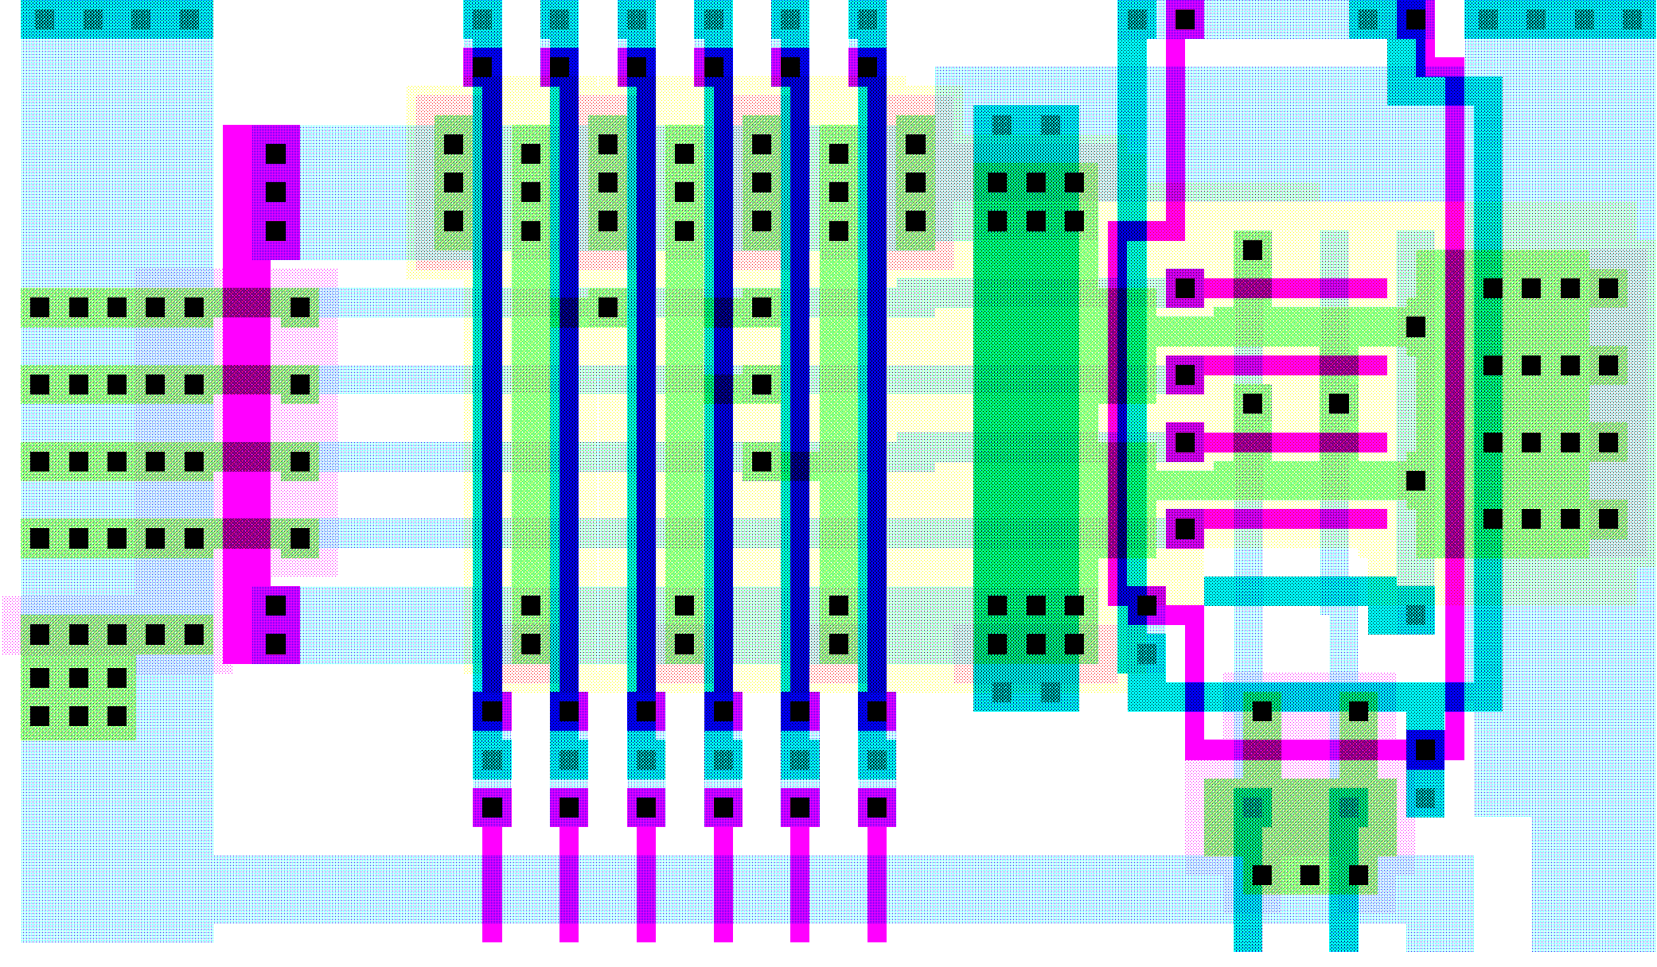
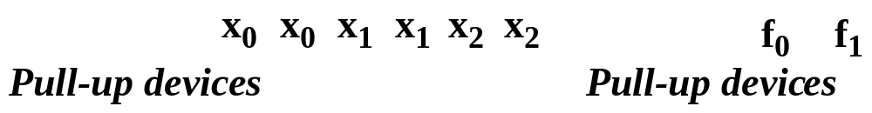
PLA Layout – Exploiting Regularity
And-Plane
Or-Plane
V
DD
φ
GND

Slide 18
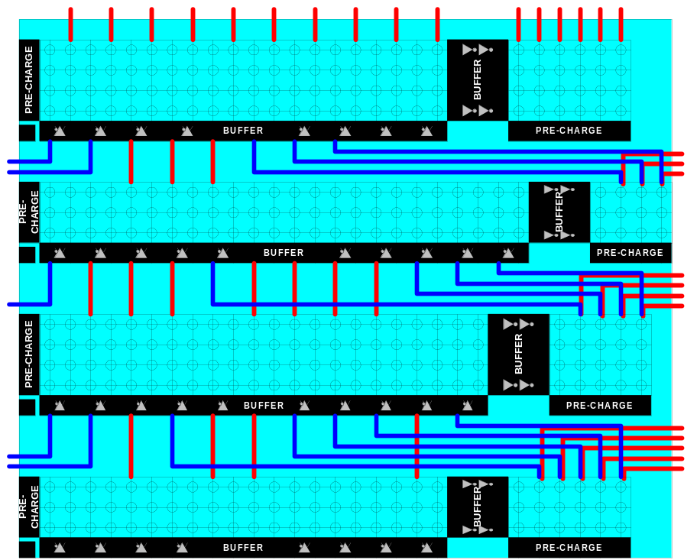
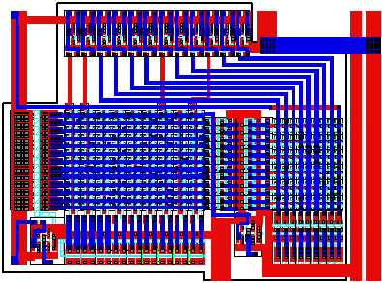
Breathing Some New Life in PLAs
River PLAs
A cascade of multiple-output PLAs.
Adjacent PLAs are connected via river routing.
No placement and routing needed.
Output buffers and the input buffers of the next stage are shared.
Courtesy B. Brayton

Slide 19
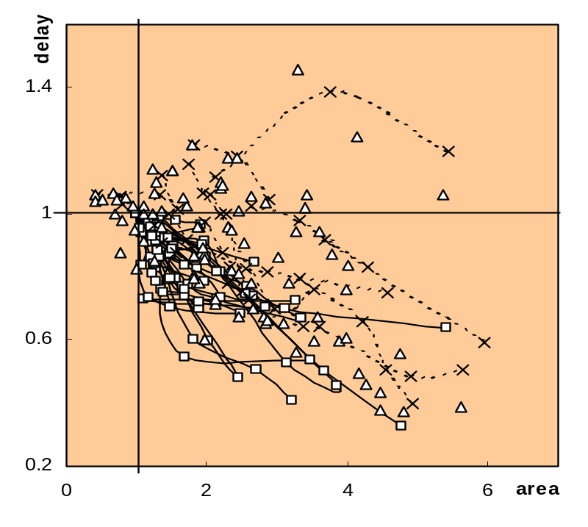
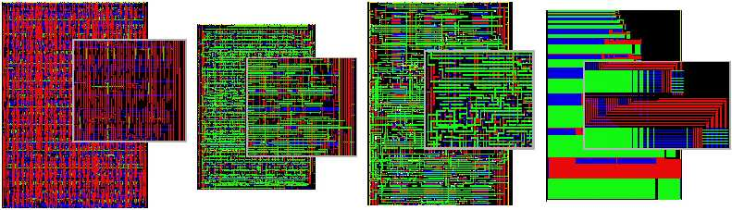
Experimental Results
Area:
RPLAs (2 layers) 1.23
SCs (3 layers) - 1.00,
NPLAs (4 layers) 1.31
Delay
RPLAs 1.04
SCs 1.00
NPLAs 1.09
Synthesis time: for RPLA , synthesis time equals design time; SCs and NPLAs still need P&R.
Also: RPLAs are regular and predictable
Layout of C2670
Standard cell,
2 layers channel routing
Standard cell,
3 layers OTC
Network of PLAs,
4 layers OTC
River PLA,
2 layers no additional routing

Slide 20
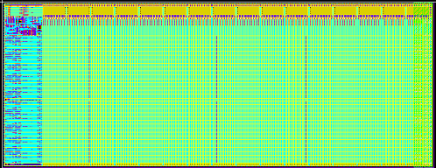
MacroModules
256×32 (or 8192 bit) SRAM
Generated by hard-macro module generator

Slide 21
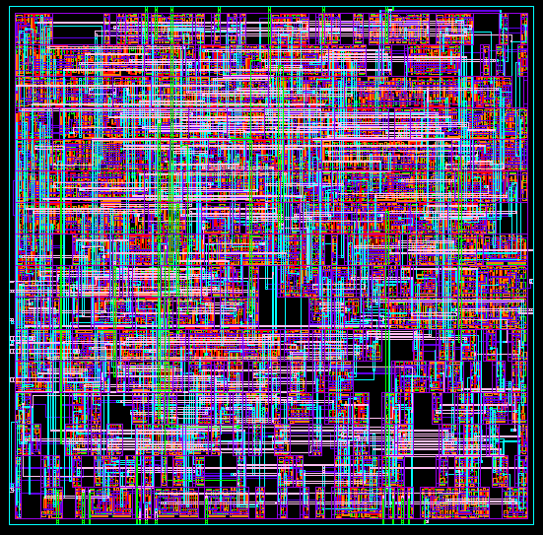
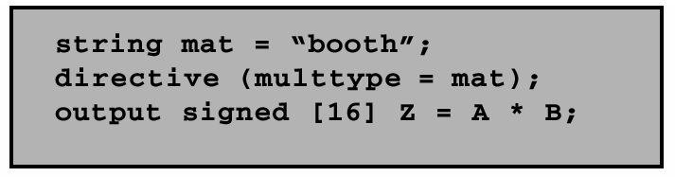
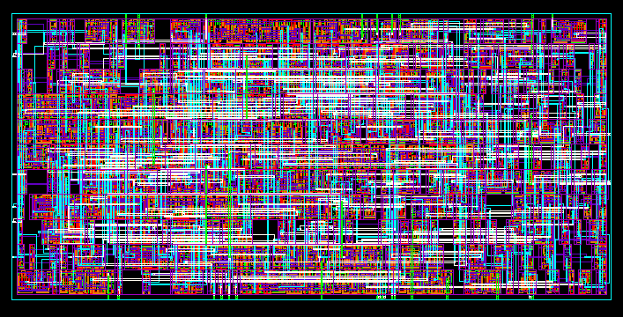
“Soft” MacroModules
Synopsys DesignCompiler

Slide 22
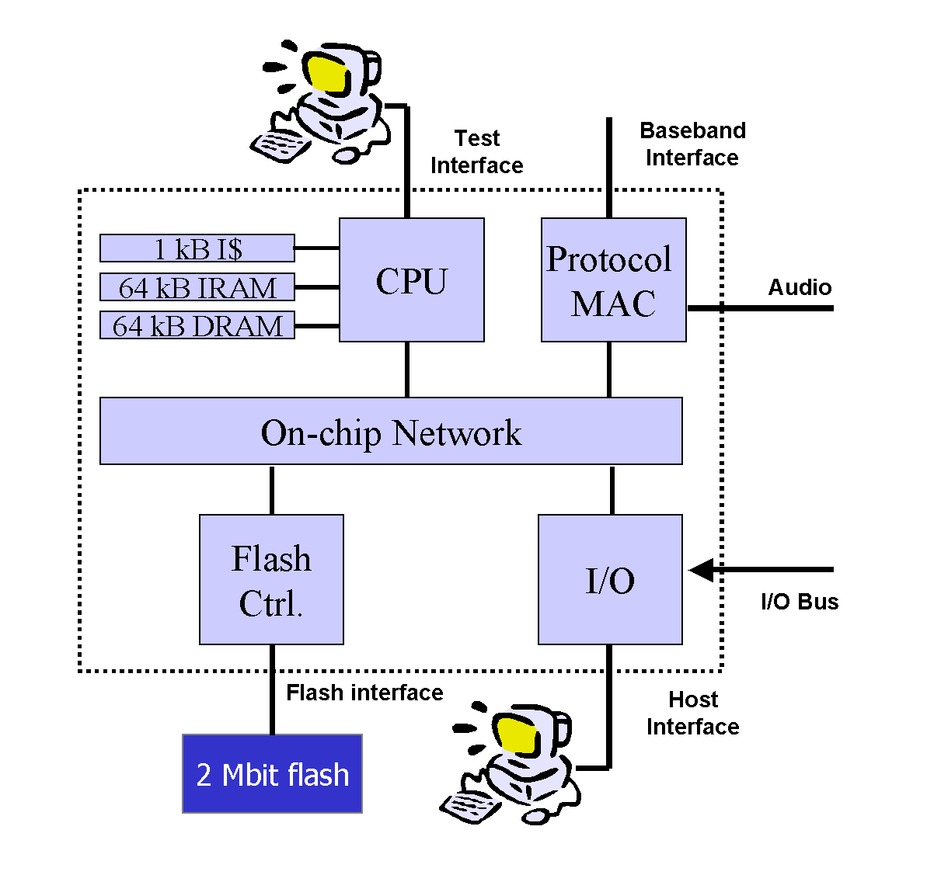
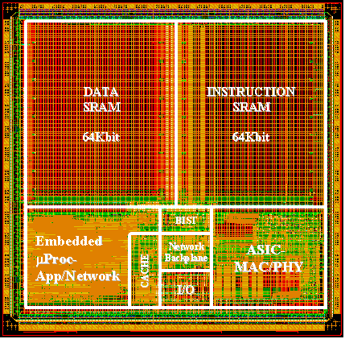
“Intellectual Property”
A Protocol Processor for Wireless

Slide 23
Semicustom Design Flow
Design Capture
Behavioral
HDL
Pre-Layout Simulation
Structural
Logic Synthesis
Design Iteration
Floorplanning
Post-Layout Simulation
Placement
Physical
Circuit Extraction
Routing
Tape-out

Slide 24
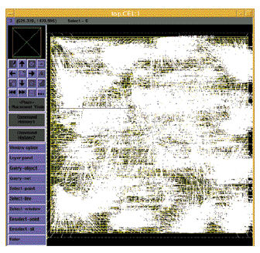
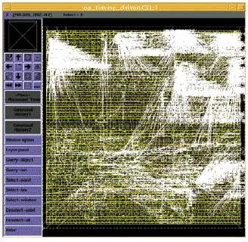
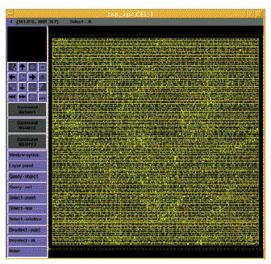
The “Design Closure” Problem
Iterative Removal of Timing Violations (white lines)
Courtesy Synopsys

Slide 25
Integrating Synthesis with
Physical Design
RTL
(Timing) Constraints
Physical Synthesis
Macromodules
Fixed netlists
Netlist with
Place-and-Route Info
Place-and-Route
Optimization
Artwork

Slide 26
Late-Binding Implementation
Array-based
Pre-diffused
Pre-wired
(Gate Arrays)
(FPGA's)

Slide 27
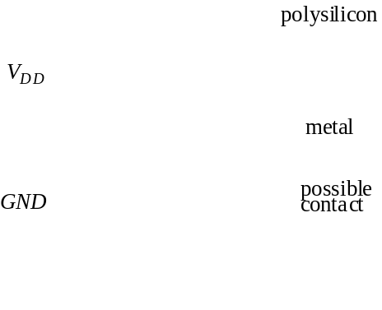
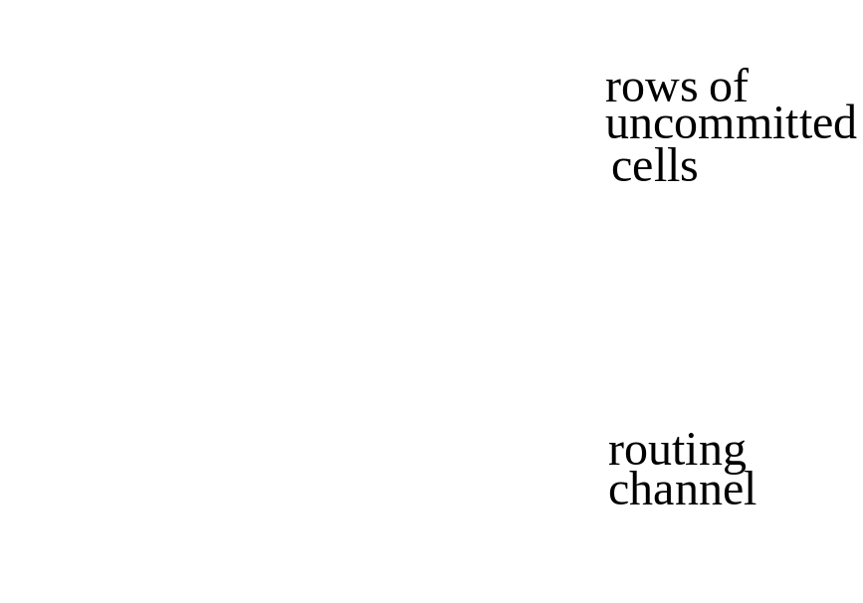
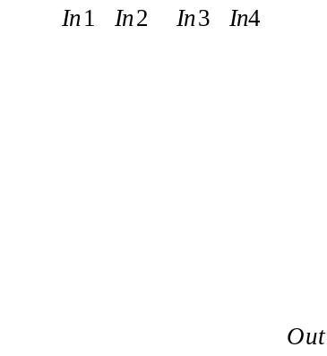
Gate Array — Sea-of-gates
Uncommited
Cell
Committed
Cell
(4-input NOR)

Slide 28
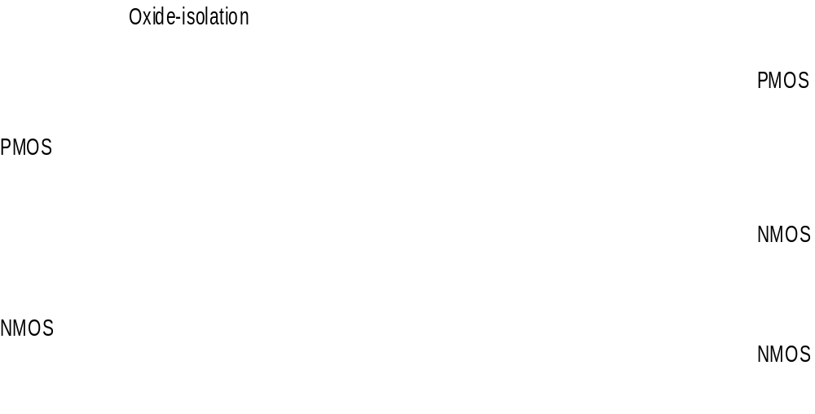
Sea-of-gate Primitive Cells
Using oxide-isolation
Using gate-isolation

Slide 29
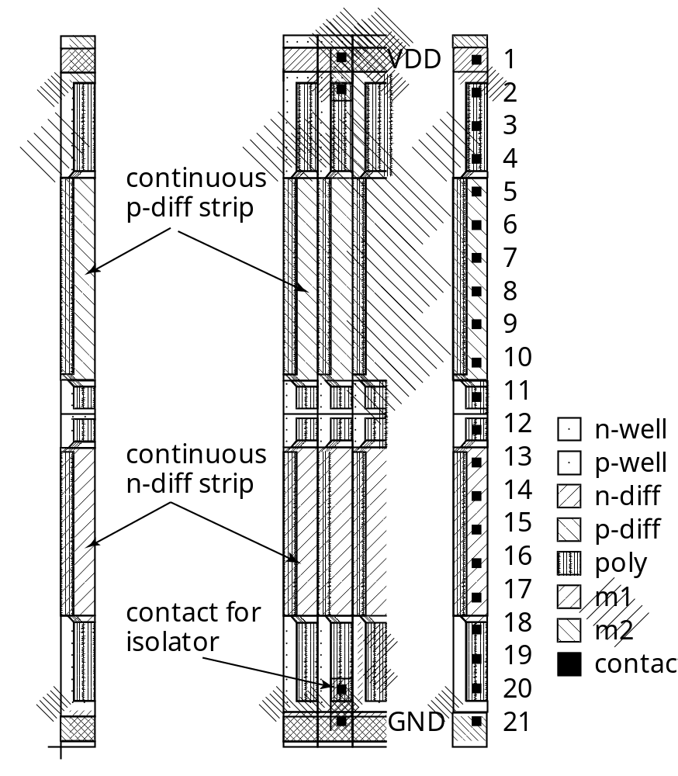
Example: Base Cell of Gate-Isolated GA
From Smith97

Slide 30
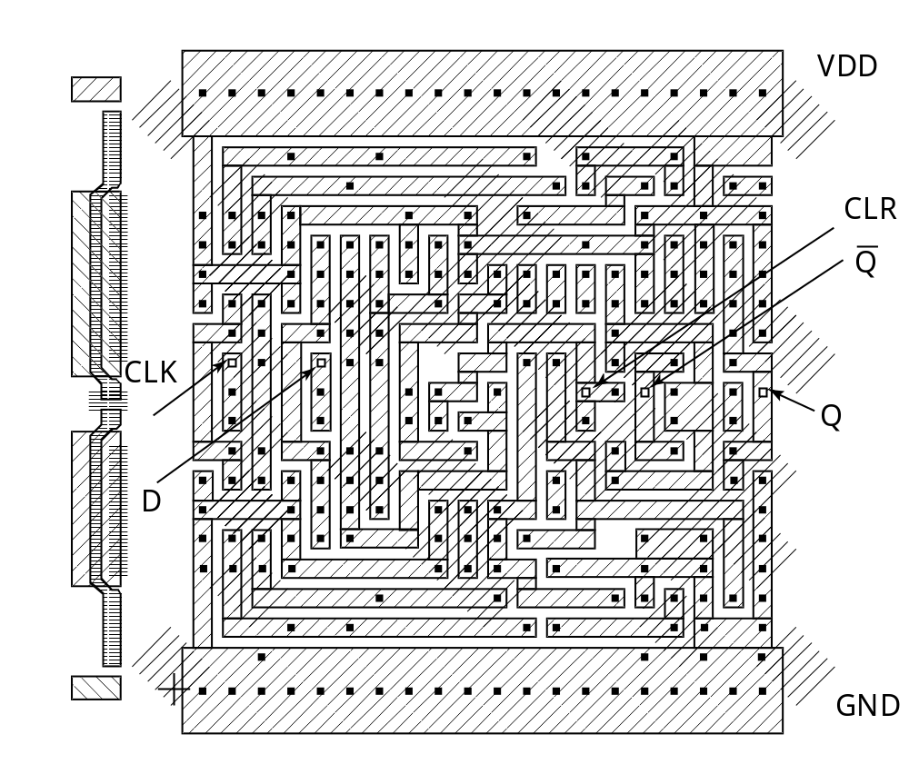
Example: Flip-Flop in Gate-Isolated GA
From Smith97

Slide 31
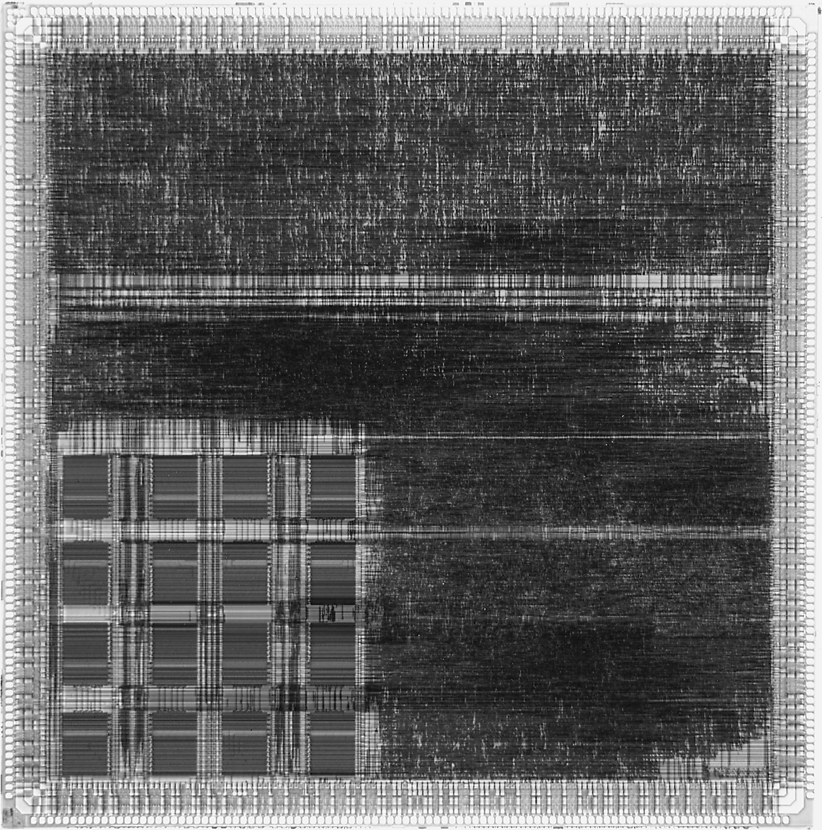
Sea-of-gates
Random Logic
Memory
Subsystem
LSI Logic LEA300K
(0.6 μm CMOS)
Courtesy LSI Logic

Slide 32
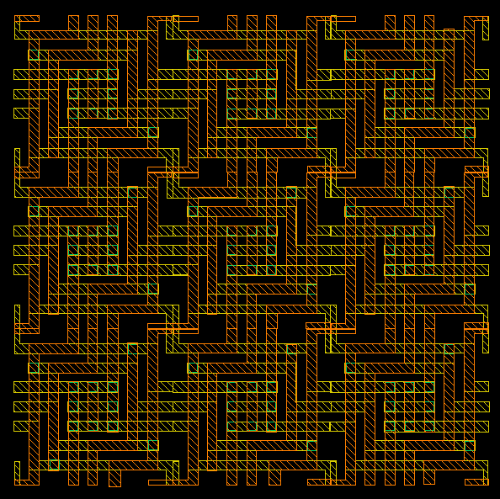
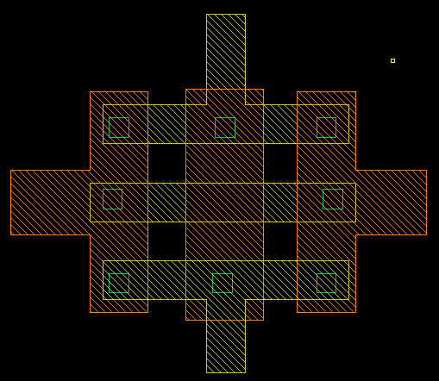
The return of gate arrays?
Via programmable gate array
(VPGA)
Via-programmable cross-point
metal-5
metal-6
programmable via
Exploits regularity of interconnect
[Pileggi02]

Slide 33
Prewired Arrays
Classification of prewired arrays (or field-programmable devices):
Based on Programming Technique
  Fuse-based (program-once)
  Non-volatile EPROM based
  RAM based
Programmable Logic Style
  Array-Based
  Look-up Table
Programmable Interconnect Style
  Channel-routing
  Mesh networks

Slide 34
Fuse-Based FPGA
antifuse polysilicon
ONO dielectric
n
⁺
antifuse diffusion
2
l
Open by default, closed by applying current pulse
From Smith97

Slide 35
Array-Based Programmable Logic
I
5
I
4
I
3
I
2
I
1
I
0
Programmable
I
I
I
I
Programmable
OR array
3
2
1
0
OR array
I
5
I
4
I
3
I
2
I
1
I
0
Fixed OR array
Programmable AND array
Fixed AND array
Programmable AND array
O
3
O
2
O
1
O
0
O
3
O
2
O
1
O
0
O
3
O
2
O
1
O
0
PLA
PROM
PAL
Indicates programmable connection
Indicates fixed connection

Slide 36
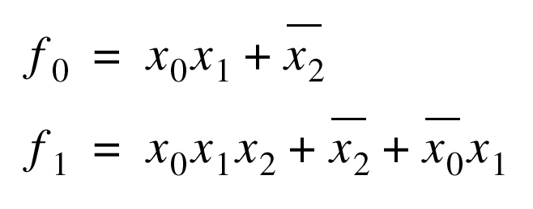
Programming a PROM
1
X
2
X
1
X
0
: programmed node
NA
NA
f
1
f
0

Slide 37
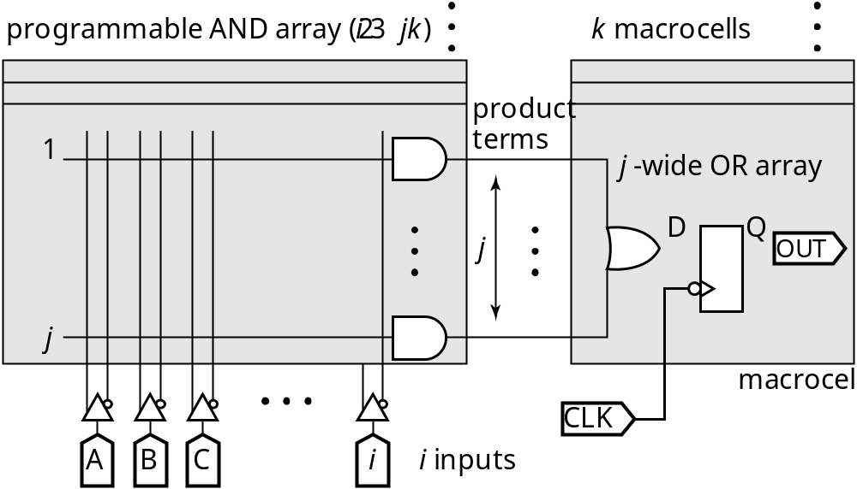
More Complex PAL
i inputs, j minterms/macrocell, k macrocells
From Smith97

Slide 38
2-input mux as programmable logic block
Configuration
A
B
S
F=
0
0
0
0
0
X
1
X
A
0
0
Y
1
Y
F
0
Y
X
XY
B
1
X
0
Y
XY
Y
0
X
XY
Y
1
X
X
1
Y
S
1
0
X
X
1
0
Y
Y
1
1
1
1

Slide 39
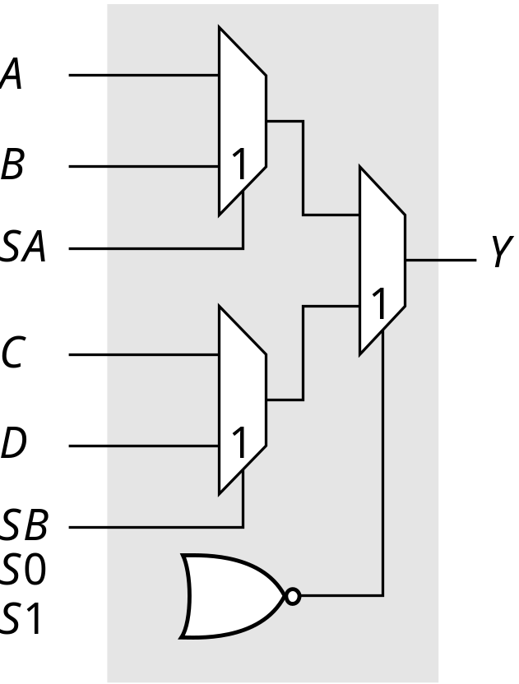
Logic Cell of Actel Fuse-Based FPGA

Slide 40
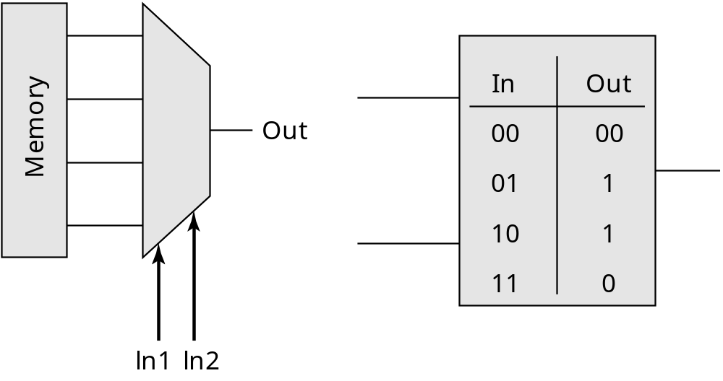
Look-up Table Based Logic Cell

Slide 41
LUT-Based Logic Cell
Figure must be
updated
C
....C
4
1
4
xx
xxxx
xxxx
xxxx
D
4
Bits
xxxx
Logic
xx
control
xx
D
3
function
xx
x
xx
x
of
xx
D
xx
2
xxx
D
1
Logic
function
x
xx
xx
of
x
x
x
x
F
xxx
4
Bits
xxxx
F
Logic
xx
control
xx
3
function
xx
x
xx
x
F
of
xx
2
xx
F
xxx
1
x
xx
xx
xxxxx
H
x
x
P
Multiplexer Controlled
Xilinx 4000 Series
by Configuration Program
Courtesy Xilinx

Slide 42
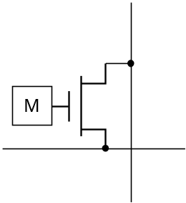
Array-Based Programmable Wiring
Interconnect
Point
Programmed interconnection
Input/output pin
Cell
Horizontal
tracks
Vertical tracks

Slide 43
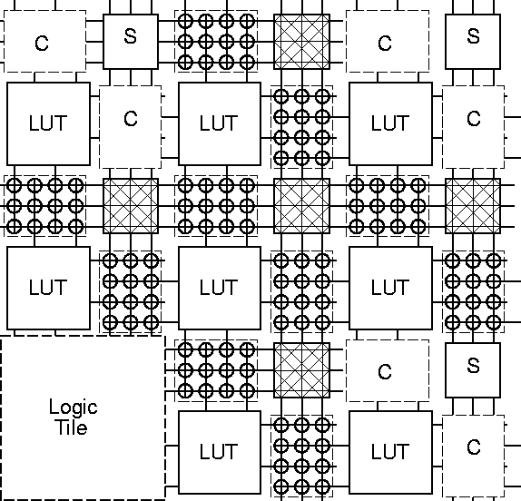
Mesh-based Interconnect Network
Switch Box
Connect Box
Interconnect
Point
Courtesy Dehon and Wawrzyniek

Slide 44
Transistor Implementation of Mesh
Courtesy Dehon and Wawrzyniek

Slide 45
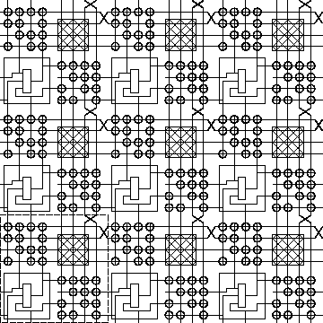
Hierarchical Mesh Network
Use overlayed mesh
to support longer connections
Reduced fanout and reduced
resistance
Courtesy Dehon and Wawrzyniek

Slide 46

EPLD Block Diagram
Primary inputs
Macrocell
Courtesy Altera

Slide 47

Altera MAX
From Smith97

Slide 48
Altera MAX Interconnect Architecture
column channel
row channel
t
PIA
LAB1
LAB2
LAB
PIA
t
PIA
LAB6
Array-based
(MAX 3000-7000)
Mesh-based
(MAX 9000)
Courtesy Altera

Slide 49

Field-Programmable Gate Arrays
Fuse-based
Standard-cell like
floorplan

Slide 50
Xilinx 4000 Interconnect Architecture
12
Quad
8
Single
4
Double
3
Long
CLB
2
Direct
Connect
3
Long
12
4
4
8
4
8
4
2
Quad
Long
Global
Long
Double
Single
Global
Carry
Direct
Clock
Clock
Chain
Connect
Courtesy Xilinx

Slide 51

RAM-based FPGA
Xilinx XC4000ex
Courtesy Xilinx

Slide 52

A Low-Energy FPGA (UC Berkeley)
Array Size: 8x8 (2 x 4 LUT)
Power Supply: 1.5V & 0.8V
Configuration: Mapped as RAM
Toggle Frequency: 125MHz
Area: 3mm x 3mm

Slide 53

Larger Granularity FPGAs
PADDI-2 (UC Berkeley)
1-mm 2-metal
CMOS tech
1.2 x 1.2 mm²
600k transistors
208-pin PGA
fclock = 50 MHz
^{P}_{av} = 3.6 W @ 5V
Basic Module: Datapath

Slide 54
Design at a crossroad
System-on-a-Chip
Multi-
Spectral
Imager
500 k Gates FPGA
+ 1 Gbit DRAM
Preprocessing
Embedded applications where cost, performance, and energy are the real issues!
DSP and control intensive
Mixed-mode
Combines programmable and application-specific modules
Software plays crucial role
Analog
RAM
64 SIMD Processor
Array + SRAM
Image Conditioning
100 GOPS
μC
system
+2 Gbit
DRAM
Recog-
nition

Slide 55

Addressing the Design Complexity Issue
Architecture Reuse
Reuse comes in generations
Source: Theo Claasen (Philips) – DAC 00

Slide 56
Architecture ReUse
Silicon System Platform
  Flexible architecture for hardware and software
  Specific (programmable) components
  Network architecture
  Software modules
  Rules and guidelines for design of HW and SW
Has been successful in PC’s
  Dominance of a few players who specify and control architecture
Application-domain specific (difference in constraints)
  Speed (compute power)
  Dissipation
  Costs
  Real / non-real time data

Slide 57
Platform-Based Design
“Only the consumer gets freedom of choice;
designers need freedom from choice”
(Orfali, et al, 1996, p.522)
A platform is a restriction on the space of possible implementation choices, providing a well-defined abstraction of the underlying technology for the application developer
New platforms will be defined at the architecture-micro-architecture boundary
They will be component-based, and will provide a range of choices from structured-custom to fully programmable implementations
Key to such approaches is the representation of communication in the platform model
Source:R.Newton

Slide 58

Berkeley Pleiades Processor
0.25um 6-level metal CMOS
5.2mm x 6.7mm
1.2 Million transistors
40 MHz at 1V
2 extra supplies: 0.4V, 1.5V
1.5~2 mW power dissipation
FPGA
Reconfigurable
Data-path
Interface
ARM8 Core

Slide 59

Heterogeneous Programmable Platforms
FPGA Fabric
Embedded memories
Embedded PowerPc
Hardwired multipliers
Xilinx Vertex-II Pro
High-speed I/O
Courtesy Xilinx

Slide 60
Summary
Digital CMOS Design is kicking and healthy
Some major challenges down the road caused by Deep Sub-micron
  Super GHz design
  Power consumption!!!!
  Reliability – making it work
  Some new circuit solutions are bound to emerge
Who can afford design in the years to come? Some major design methodology change in the making!

